Slide 1
Introduction to Film Studies
Your Tas
Adhiraj Deshmukh
Vanshpreet Kohli

Slide 2
Grading Plan
Quiz 1 10%
Mid Sem Exam 20%
Quiz 2 10%
Assignment 1 30%
Assignment 2 30%

Slide 3
A grades for going beyond what is expected
B grades for meeting expectations
C grades for doing less than expected
An automatic F for the assignment and the course in cases of plagiarism an AI (over 20%).
Credit will be given for creative thinking
No one gets full marks in the Human Sciences

Slide 4
Why study cinema
Cinema is a language.
Sign system, grammar, layers of meanings
More than the sum of its parts
Poetry, prose, Serialized fiction

Slide 5
Some terms
Diegesis – the world of the movie (X-men vs. Barbie vs Kalki)
Mise-en-scène – everything in front of the camera –properties, actors, blocking, scene/stage-design
Shot size – distance from the camera
Take – an uninterrupted run of film

Slide 6
Four aspects
Cinematography
Editing
Sound
Narrative

Slide 7
Cinematography – Basic terms
Shot Sizes
Camera Movements
Lighting
Aspect Ratio

Slide 8
Shot/Shot Size
Field size – what and how much is seen
Extreme close-up to extreme long shot
EXTREME Close-up
Close-up

Slide 9
Mid-shot/American Mid-shot
Full Shot
Long Shot, EXTREME Long Shot
Establishing shot, Master Shot, Bird’s eye view

Slide 10

Extreme close-up – Part objects

Slide 11

Close-Up

Slide 12

Medium Shot

Slide 13
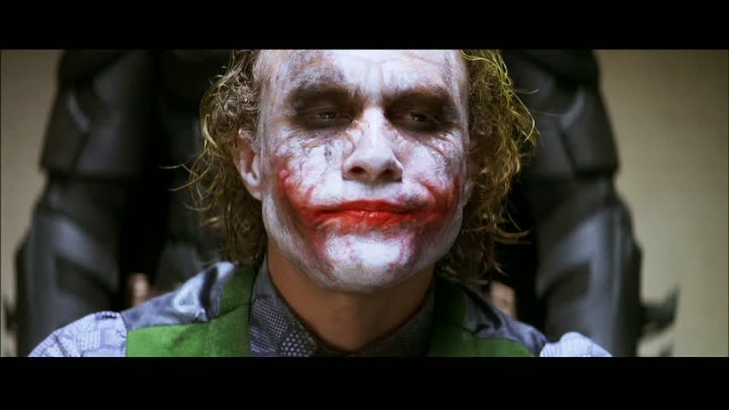
Medium Close-up

Slide 14

Cowboy/American Mid-shot

Slide 15

Long Shot

Slide 16
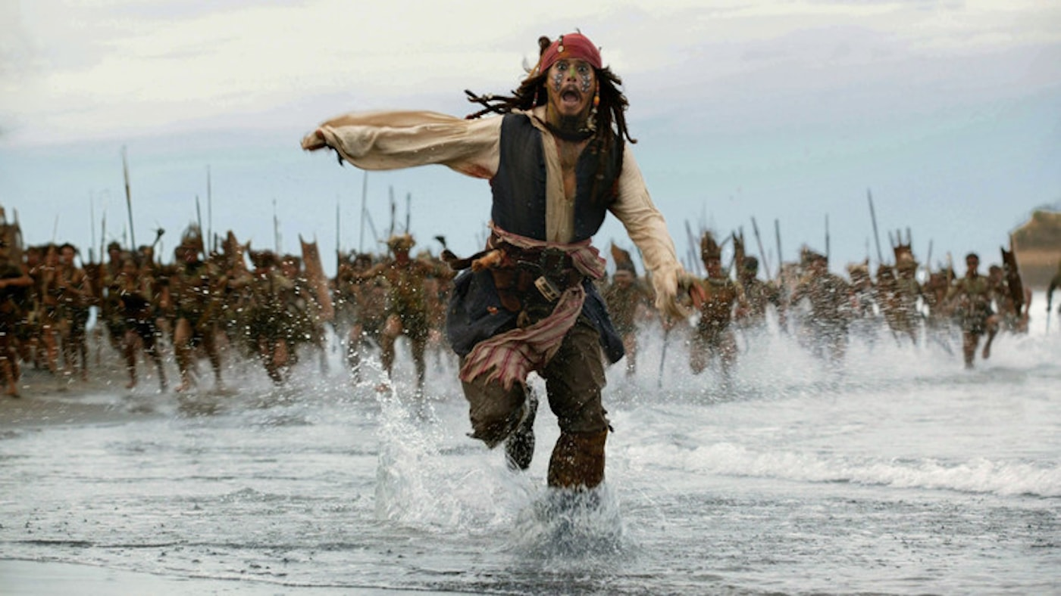
Full shot

Slide 17

Extreme Long-shot

Slide 18

Establishing Shot

Slide 19
